Slide 1
Introducing Recommendation Systems
Scott O’Hara
Metrowest Developers Machine Learning Group
04/28/2021

Slide 2
References
The material for this talk is primarily drawn from the notes, slides and lectures of the courses and book below:
Machine Learning Foundations: A Case Study Approach
University of Washington, Prof. Emily Fox & Prof. Carlos Guestrin
https://www.coursera.org/learn/ml-foundations
CSE/STAT 416 - Intro to Machine Learning Spring 2018
University of Washington, Prof. Emily Fox, Spring 2018
https://courses.cs.washington.edu/courses/cse416/18sp/index.html
University of Washington, Sewoong Oh, Spring 2019
https://courses.cs.washington.edu/courses/cse416/19sp/index.html
University of Washington, Vinitra Swamy, Summer 2020
https://courses.cs.washington.edu/courses/cse416/20su/index.html

Slide 3
Why Recommender Systems? Personalization

Slide 4
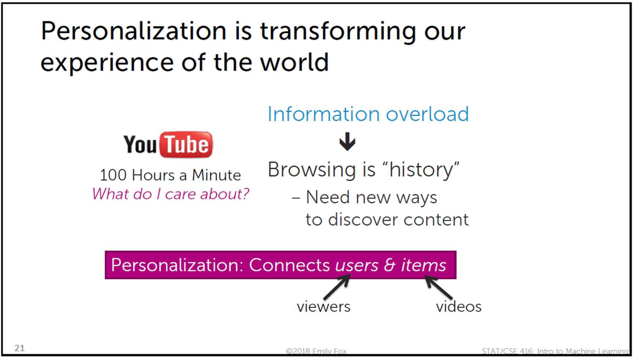

Slide 5
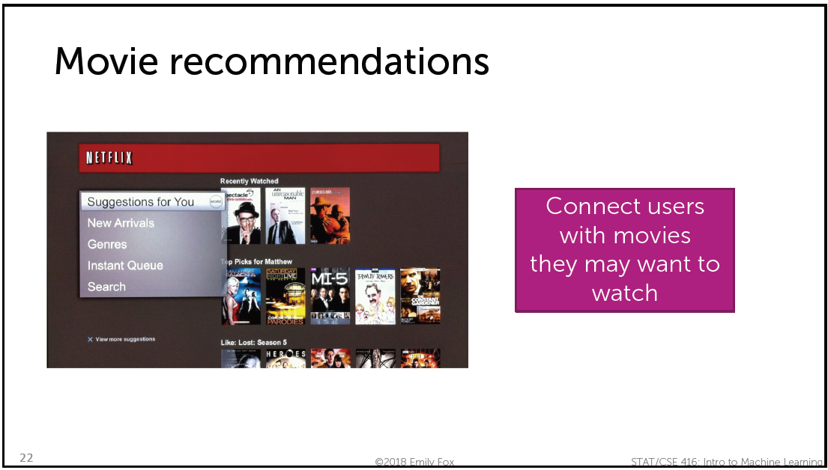

Slide 10
What are the Challenges of Developing Recommendation Systems?

Slide 12


Slide 13


Slide 16
Approaches to Building a Recommender System

Slide 17
Approaches to Building a Recommender System
Solution 0: Popularity
Solution 1: Content-based Filtering (Classification Model)
Solution 2: Collaborative Filtering (People who bought this also bought …)
Solution 3: Discovering Hidden Structure by Matrix Factorization
Bringing it all together: Featurized Matrix Factorization

Slide 18
Solution 0: Popularity

Slide 20
Solution 1: Content-based Filtering (Classification Model)

Slide 23
Solution 2: Collaborative Filtering (People who bought this also bought …)

Slide 27
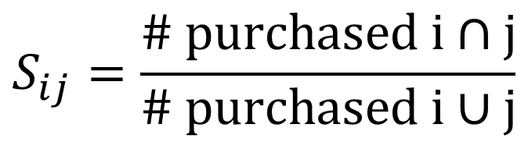

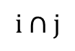
$$S_{ij}=\frac{\text{\# }\text{purchased} \text{i}\text{ ∩ }\text{j}}{\text{\# }\text{purchased} \text{i}\text{ ∪ }\text{j}}$$
i
$$\text{i}\text{ ∩ }\text{j}$$
j
$$\text{i}\text{ ∪ }\text{j}$$

Slide 28
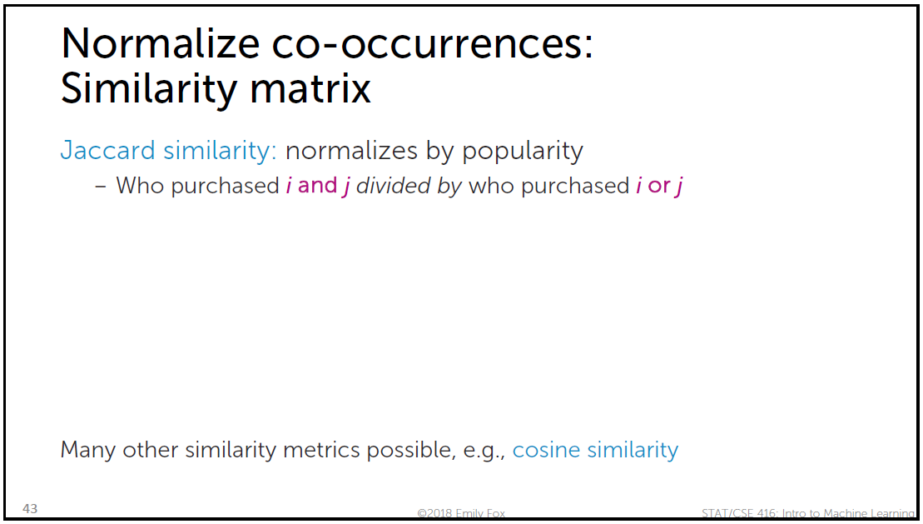
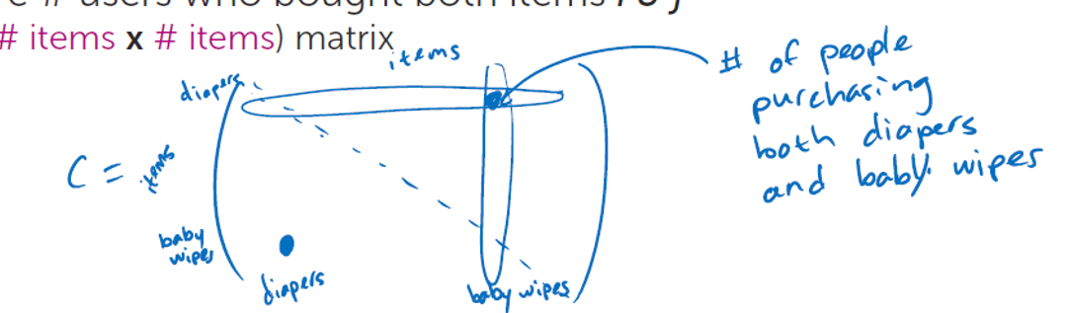
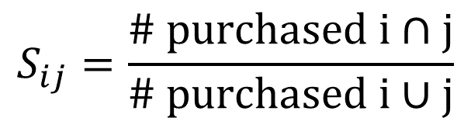
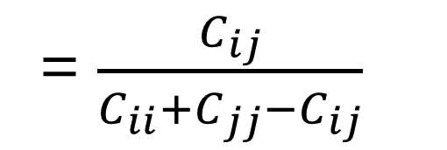
$$S_{ij}=\frac{\text{\# }\text{purchased} \text{i}\text{ ∩ }\text{j}}{\text{\# }\text{purchased} \text{i}\text{ ∪ }\text{j}}$$
= $\frac{C_{ij}}{C_{ii}+C_{jj}−C_{ij}}$

Slide 32
Solution 3: Discovering Hidden Structure by Matrix Factorization

Slide 33
How Recommender Systems Work (Netflix/Amazon)
- Art of the Problem
https://www.youtube.com/watch?v=n3RKsY2H-NE

Slide 38
Example: Predict a User’s Rating:
We can describe each movie v with feature vector R_{v}
How much is the movie action, romance, drama, …
R_{v} = [0.3, 0.01, 1.5, …]
We can describe each user u with feature vector L_{u}
How much the user likes action, romance, drama, …
L_{u} = [2.3, 0.0, 0.7, …]
Predict rating of movie user has not seen with inner product:
Rating(u,v) = 0.3*2.3 + 0.01*0.0 + 1.5*0.7 + …
Reference: CSE/STAT 416 Intro to Machine Learning, Spring 2019, University of Washington, Instructor: Sewoong Oh

Slide 39
Reference: CSE/STAT 416 Intro to Machine Learning, Spring 2019, University of Washington, Instructor: Sewoong Oh

Slide 40
Reference: CSE/STAT 416 Intro to Machine Learning, Summer 2020, University of Washington, Instructor: Vinitra Swamy

Slide 41
Reference: CSE/STAT 416 Intro to Machine Learning, Summer 2020, University of Washington, Instructor: Vinitra Swamy

Slide 42
Reference: CSE/STAT 416 Intro to Machine Learning, Summer 2020, University of Washington, Instructor: Vinitra Swamy

Slide 43
Reference: CSE/STAT 416 Intro to Machine Learning, Summer 2020, University of Washington, Instructor: Vinitra Swamy

Slide 44
Reference: CSE/STAT 416 Intro to Machine Learning, Summer 2020, University of Washington, Instructor: Vinitra Swamy

Slide 45
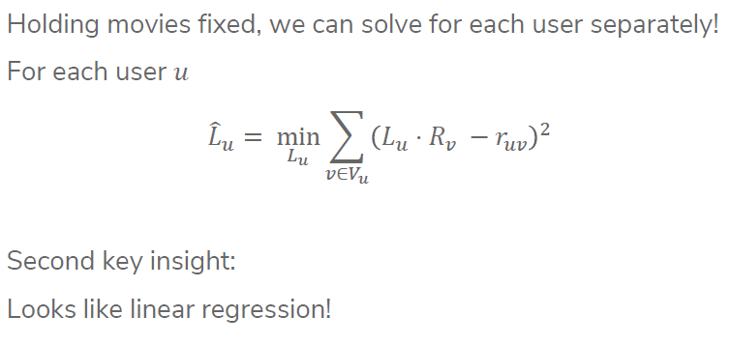
Reference: CSE/STAT 416 Intro to Machine Learning, Summer 2020, University of Washington, Instructor: Vinitra Swamy

Slide 46
Reference: CSE/STAT 416 Intro to Machine Learning, Summer 2020, University of Washington, Instructor: Vinitra Swamy

Slide 47
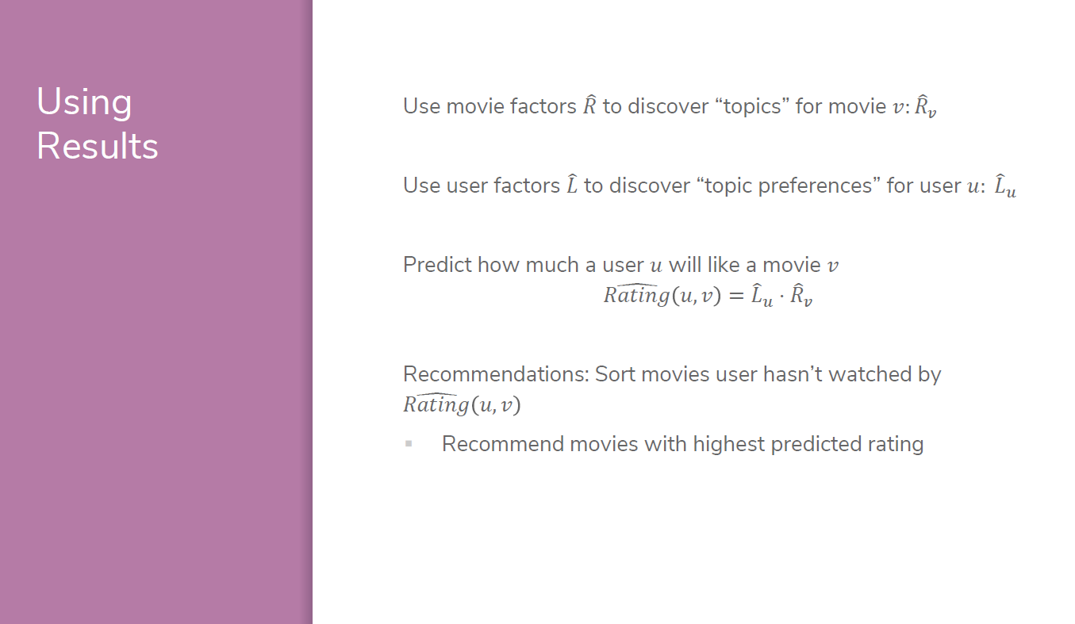
Reference: CSE/STAT 416 Intro to Machine Learning, Summer 2020, University of Washington, Instructor: Vinitra Swamy

Slide 48
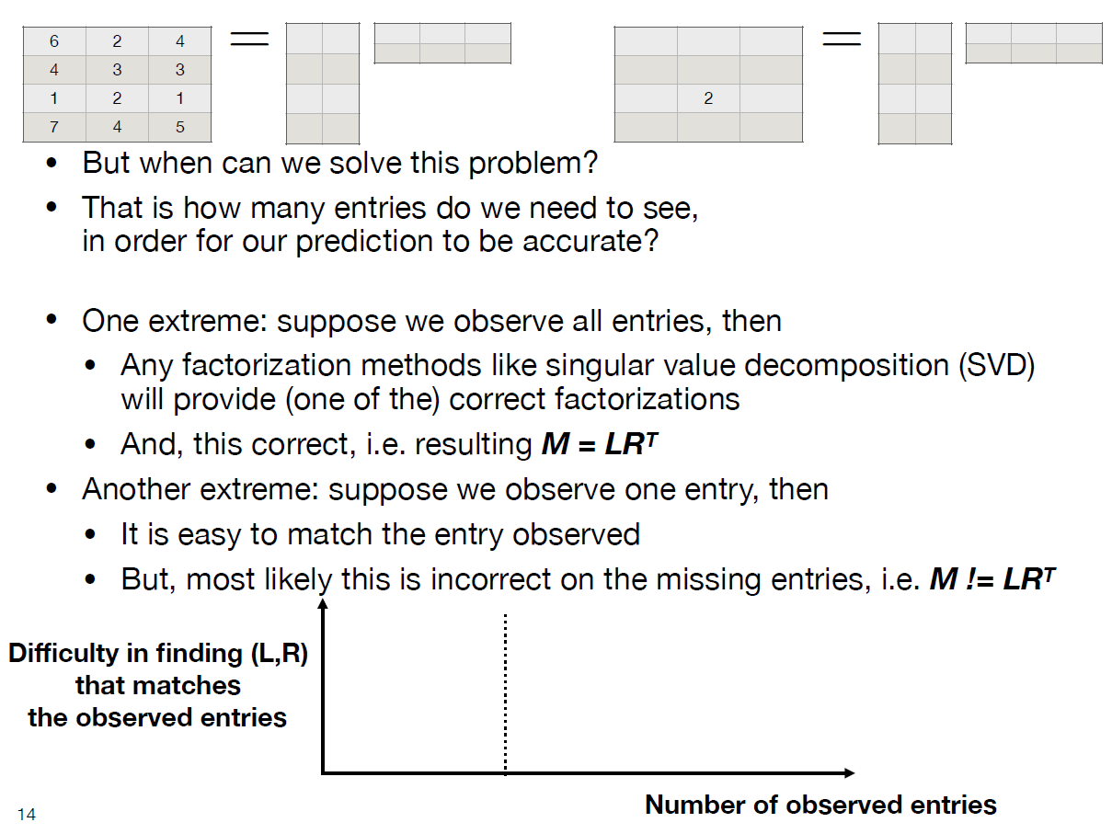
Reference: CSE/STAT 416 Intro to Machine Learning, Spring 2019, University of Washington, Instructor: Sewoong Oh

Slide 49
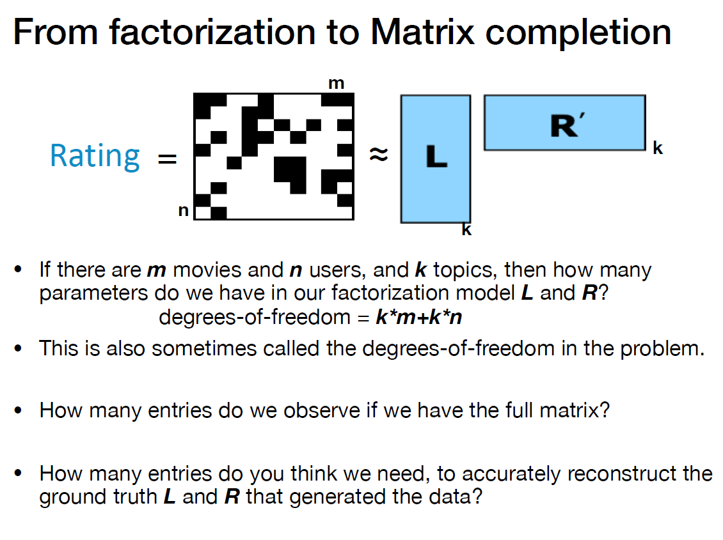
Reference: CSE/STAT 416 Intro to Machine Learning, Spring 2019, University of Washington, Instructor: Sewoong Oh

Slide 50
Example:
2000 x 2000
rank-8 random matrix
Reference: CSE/STAT 416 Intro to Machine Learning, Spring 2019, University of Washington, Instructor: Sewoong Oh

Slide 51
Example:
2000 x 2000
rank-8 random matrix
Reference: CSE/STAT 416 Intro to Machine Learning, Spring 2019, University of Washington, Instructor: Sewoong Oh

Slide 52
Example:
2000 x 2000
rank-8 random matrix
Reference: CSE/STAT 416 Intro to Machine Learning, Spring 2019, University of Washington, Instructor: Sewoong Oh

Slide 53
Example:
2000 x 2000
rank-8 random matrix
Reference: CSE/STAT 416 Intro to Machine Learning, Spring 2019, University of Washington, Instructor: Sewoong Oh

Slide 54
Example:
2000 x 2000
rank-8 random matrix
Reference: CSE/STAT 416 Intro to Machine Learning, Spring 2019, University of Washington, Instructor: Sewoong Oh

Slide 55
Example:
2000 x 2000
rank-8 random matrix
Reference: CSE/STAT 416 Intro to Machine Learning, Spring 2019, University of Washington, Instructor: Sewoong Oh

Slide 56
Example:
2000 x 2000
rank-8 random matrix
Reference: CSE/STAT 416 Intro to Machine Learning, Spring 2019, University of Washington, Instructor: Sewoong Oh

Slide 57
Reference: CSE/STAT 416 Intro to Machine Learning, Spring 2019, University of Washington, Instructor: Sewoong Oh

Slide 58
Bringing it all together: Featurized Matrix Factorization

Slide 59
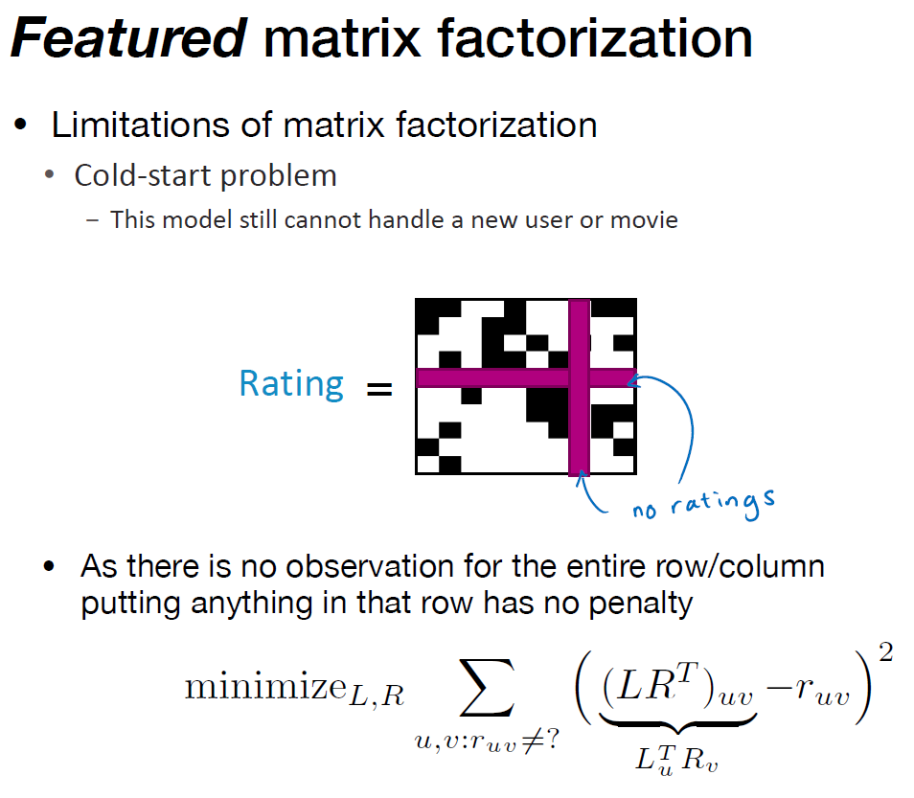
Reference: CSE/STAT 416 Intro to Machine Learning, Spring 2019, University of Washington, Instructor: Sewoong Oh

Slide 61
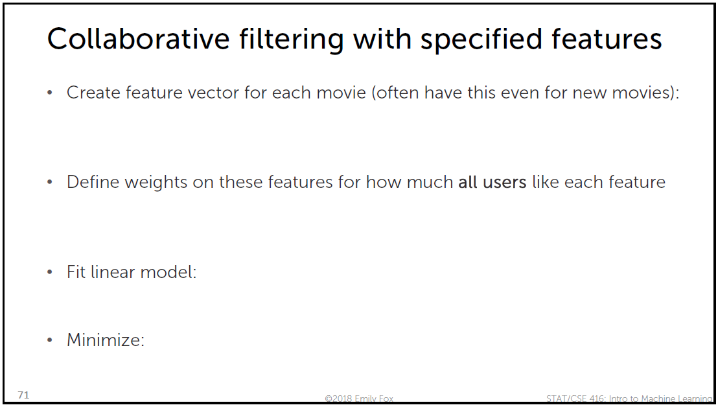

Slide 62
Reference: CSE/STAT 416 Intro to Machine Learning, Spring 2019, University of Washington, Instructor: Sewoong Oh

Slide 63
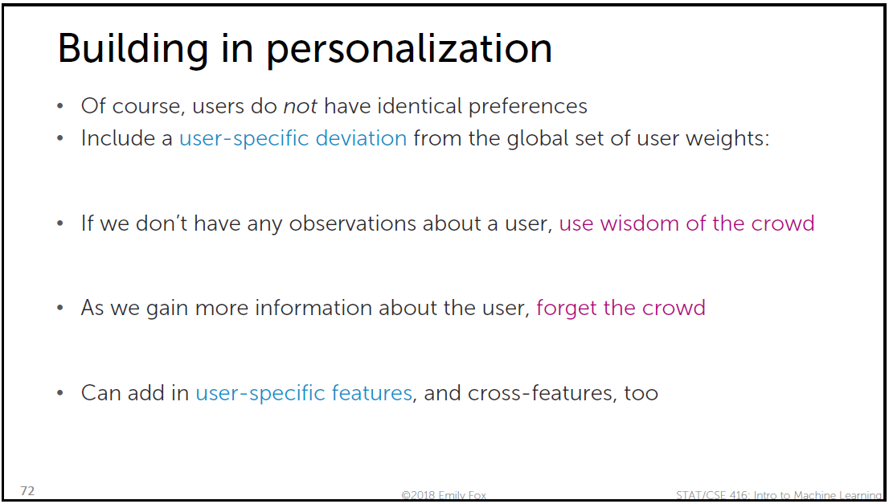

Slide 64
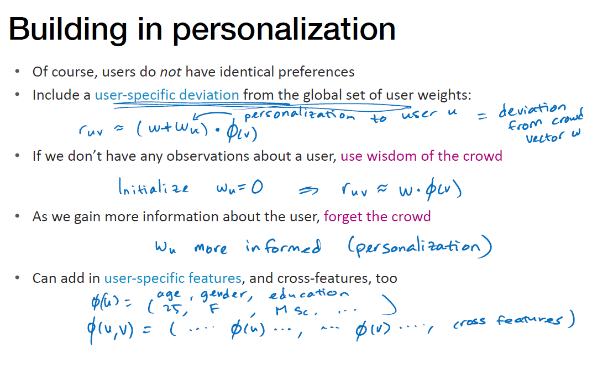
Reference: CSE/STAT 416 Intro to Machine Learning, Spring 2019, University of Washington, Instructor: Sewoong Oh

Slide 65
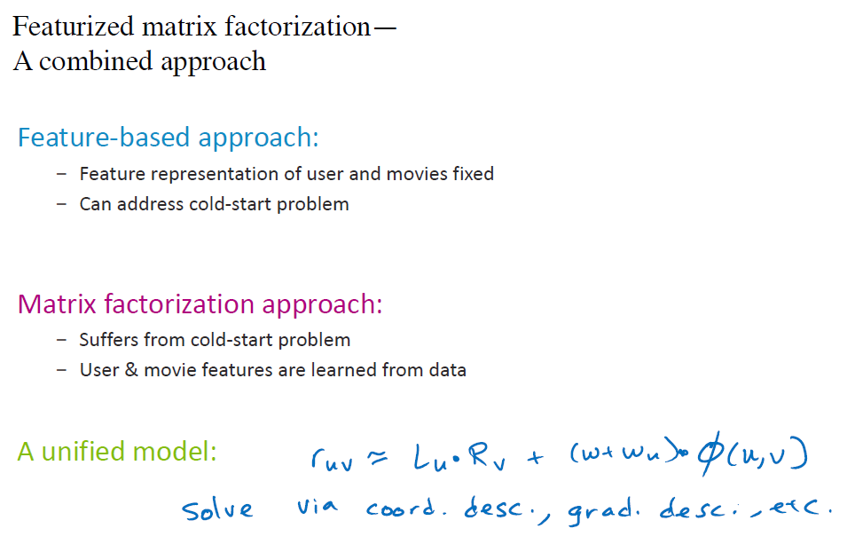
Reference: CSE/STAT 416 Intro to Machine Learning, Spring 2019, University of Washington, Instructor: Sewoong Oh

Slide 66
Introducing Recommendation Systems
Scott O’Hara
Metrowest Developers Machine Learning Group
03/31/2021

Slide 67
Extra Slides

Slide 68
Reference: CSE/STAT 416 Intro to Machine Learning, Summer 2020, University of Washington, Instructor: Vinitra Swamy
Reference: CSE/STAT 416 Intro to Machine Learning, Summer 2020
University of Washington, Instructor: Vinitra Swamy

Slide 69
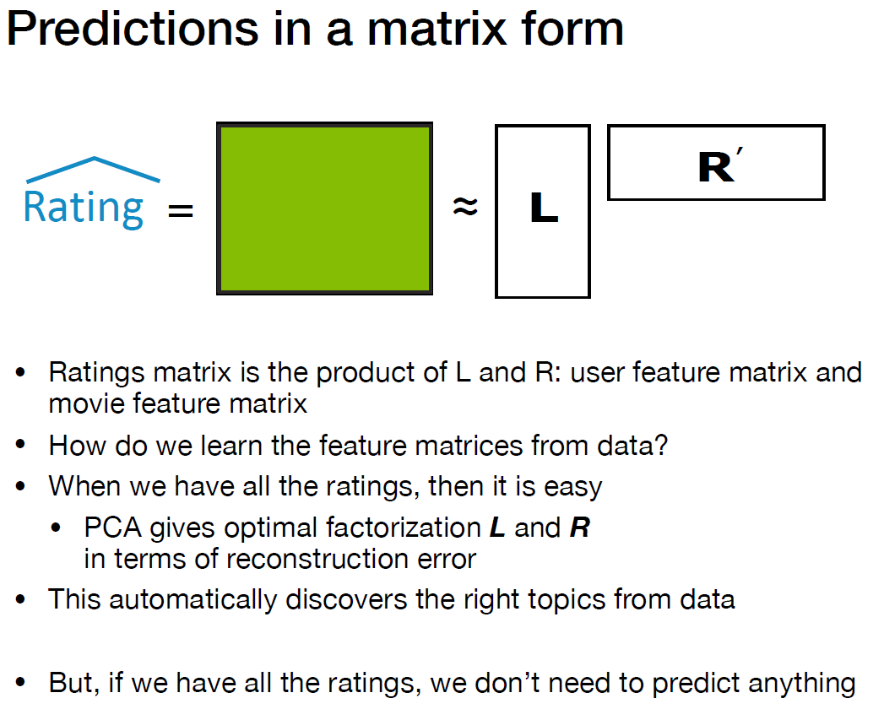
Reference: CSE/STAT 416 Intro to Machine Learning, Spring 2019, University of Washington, Instructor: Sewoong Oh

Slide 70
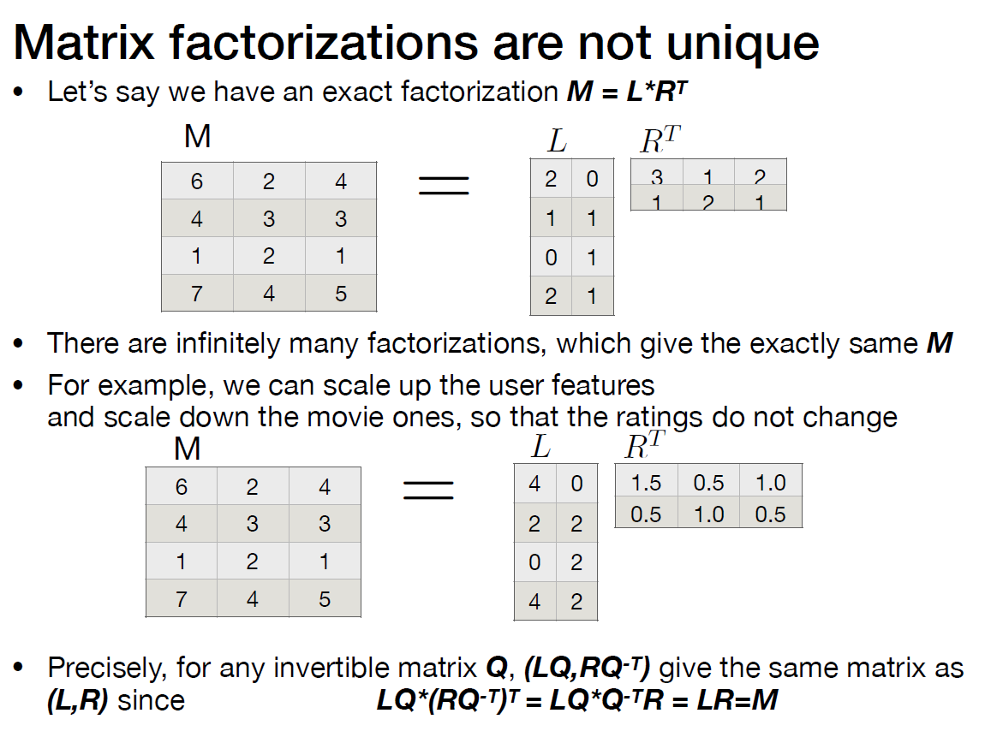
Reference: CSE/STAT 416 Intro to Machine Learning, Spring 2019, University of Washington, Instructor: Sewoong Oh

Slide 71
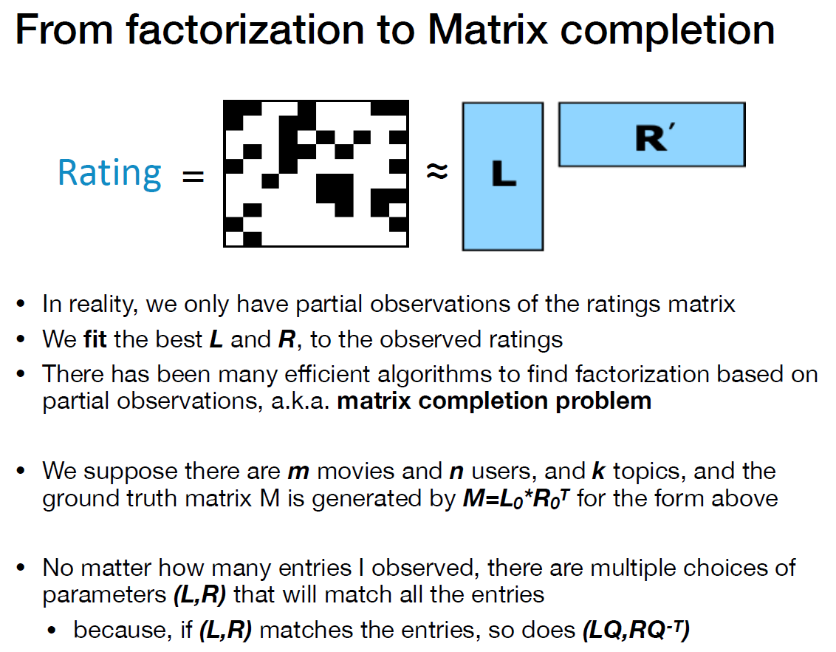
Reference: CSE/STAT 416 Intro to Machine Learning, Spring 2019, University of Washington, Instructor: Sewoong Oh

Slide 72
Reference: CSE/STAT 416 Intro to Machine Learning, Spring 2019, University of Washington, Instructor: Sewoong Oh

Slide 73
Reference: CSE/STAT 416 Intro to Machine Learning, Spring 2019, University of Washington, Instructor: Sewoong Oh

Slide 74
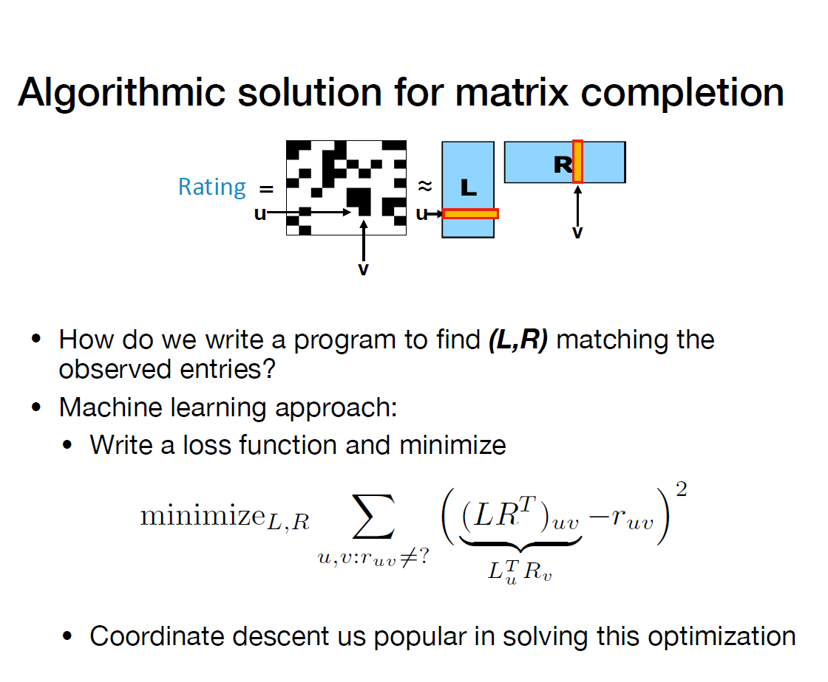
Reference: CSE/STAT 416 Intro to Machine Learning, Spring 2019, University of Washington, Instructor: Sewoong Oh

Slide 75
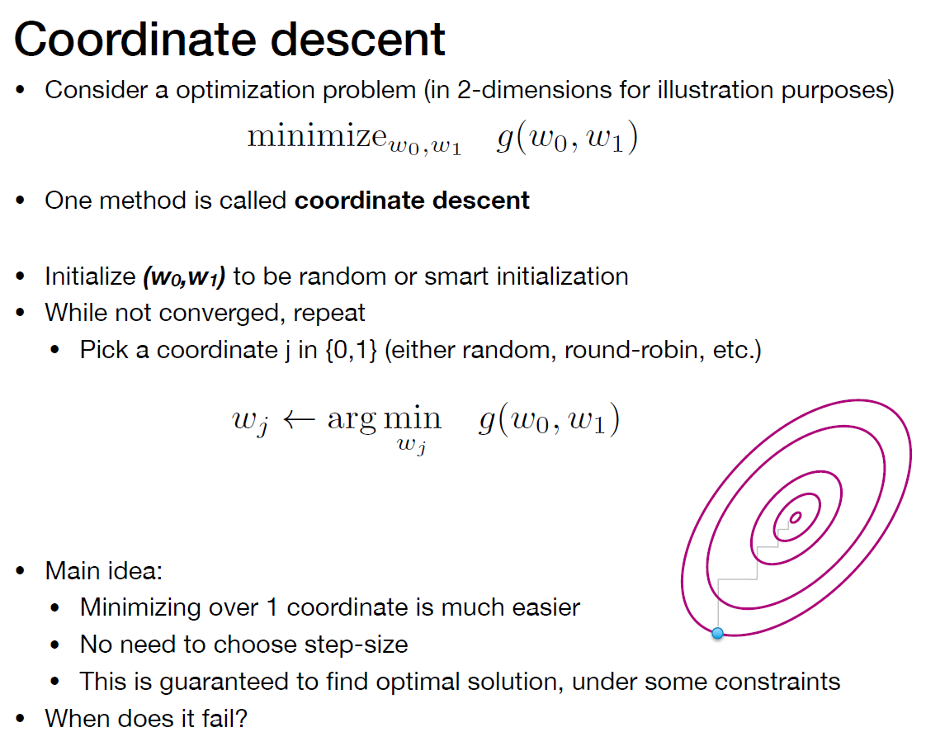
Reference: CSE/STAT 416 Intro to Machine Learning, Spring 2019, University of Washington, Instructor: Sewoong Oh

Slide 76
Reference: CSE/STAT 416 Intro to Machine Learning, Spring 2019, University of Washington, Instructor: Sewoong Oh

Slide 77
Reference: CSE/STAT 416 Intro to Machine Learning, Spring 2019, University of Washington, Instructor: Sewoong Oh

Slide 78
Reference: CSE/STAT 416 Intro to Machine Learning, Spring 2019, University of Washington, Instructor: Sewoong Oh

Slide 79
Reference: CSE/STAT 416 Intro to Machine Learning, Spring 2019, University of Washington, Instructor: Sewoong Oh

Slide 80
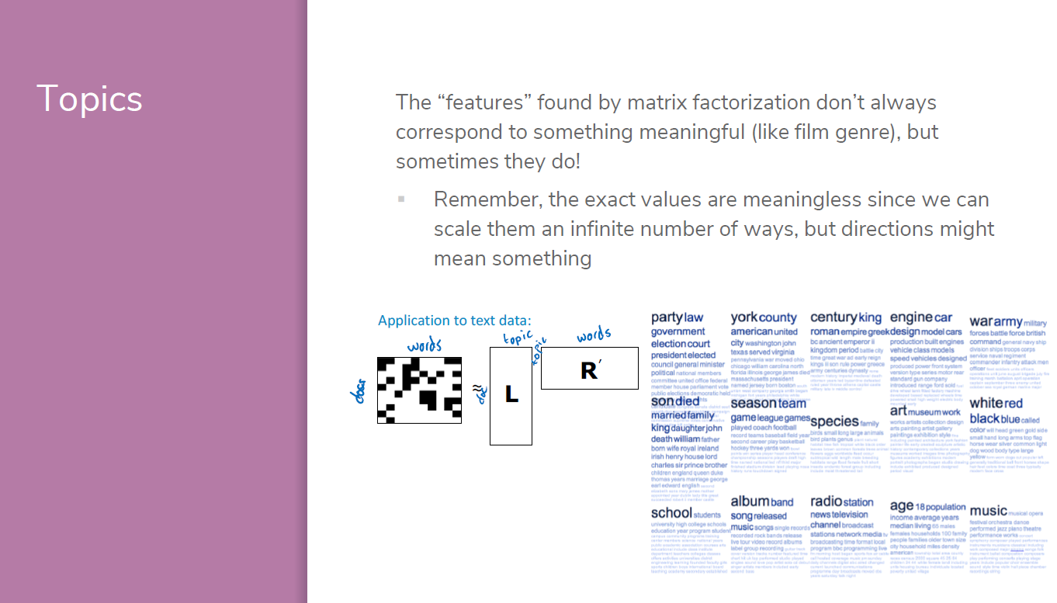
Reference: CSE/STAT 416 Intro to Machine Learning, Summer 2020, University of Washington, Instructor: Vinitra Swamy

